Slide 1










Snake GAME
USING

Slide 2


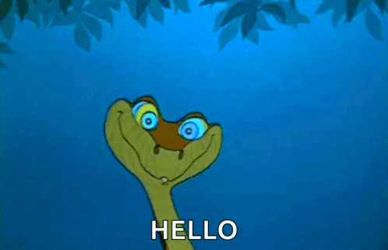





Welcome
Thank you for taking the time to view my project. In this presentation, I will walk you through the development process, the technologies used, and the unique features of the game. Let's explore how classic fun meets modern coding!"

Slide 3
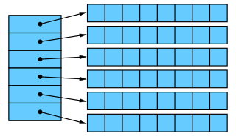
DATA STRUCTURE : ARRAYS

Slide 4







Table of Contents
Project Overview
01
02
Technologies Used
Game Design
03
04
Game Logic
Movement and Controls
05
06
Eating the Food and Growing Mechanism

Slide 5






PROJECT OVERVIEW
Key Features
Snake Movement: Controlled via the arrow keys, the snake moves smoothly on the grid.
Random Food Generation: The food appears randomly in empty spaces on the grid, and the snake must "eat" it to grow.
Scoreboard: A live score display updates as the snake consumes food.
Dynamic Speed: The game's speed increases as the snake grows, making it more challenging.
Game Over Modal: When the game ends, a modal pops up, displaying the final score with an option to restart the game.
Project Overview: 2D Snake Game
The 2D Snake Game is a web-based recreation of the classic Snake game, built using HTML, CSS, and JavaScript. The primary objective is to control a snake that moves across a grid, eating randomly placed food. Each time the snake eats the food, it grows in length, and the player's score increases. The game continues until the snake collides with the game boundaries or itself, resulting in a game over.
The project showcases how JavaScript's dynamic capabilities, especially arrays, can be utilized to manage complex game mechanics. It also demonstrates CSS’s role in creating a clean, visually appealing user interface.

Slide 6

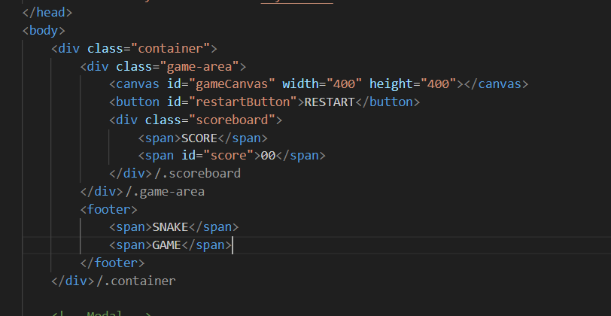
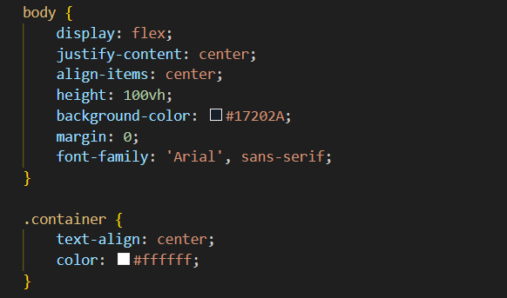
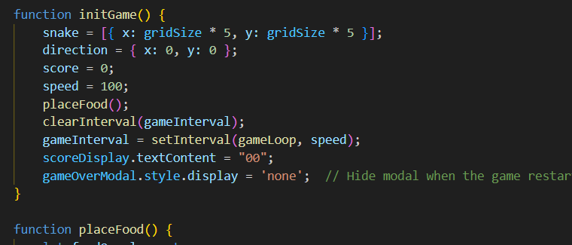
TECHNOLOGIES USED
CSS
JS
HTML
Used to style the visual elements of the game:
Created a dark-themed game area with visually appealing elements.
Styled the snake and food to have distinct colors.
Designed the restart button and scoreboard for user interaction, enhancing the game's usability.
Used CSS animations and hover effects to improve the overall user experience.
The core functionality of the game includes:
Game Logic: Manages snake movement, food generation, collision detection, and score calculation.
Event Handling: Captures arrow key inputs to control the snake’s direction.
Dynamic Updates: Continuously updates the game canvas to reflect real-time movements.
Speed Adjustments: Increases snake speed as the score rises, adding more difficulty.
Structured the game’s interface by defining elements such as:
Canvas: The area where the snake game is rendered and played.
Buttons: A restart button to allow players to restart the game.
Scoreboard: Displays the current score during gameplay.

Slide 7
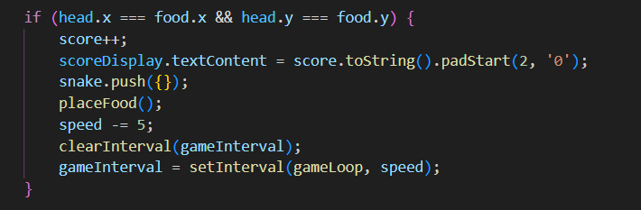
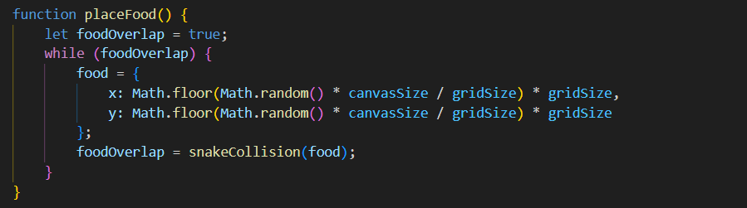
Food Generation and Growth Mechanism
Food Placement: Food is randomly placed on the grid, and the snake grows by adding a new segment when it eats the food. The game checks for overlap with the snake to ensure the food does not spawn inside the snake's body.
Growth Logic: The snake grows by adding a new segment when the head of the snake collides with the food.

Slide 8
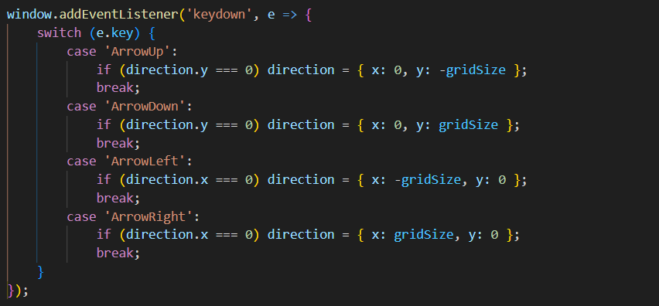
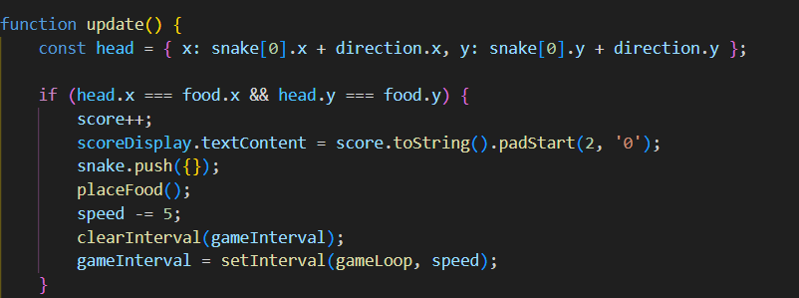
Snake Movement and Controls (JavaScript)
Movement Logic: The snake is represented as an array of segments, with the head being the first element. The direction is controlled by arrow keys, and the snake moves by updating the position of each segment based on the direction.
Keyboard Controls: The Keydown event listens for arrow key presses and updates the direction of the snake accordingly.

Slide 9
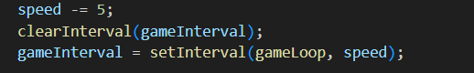
Score Calculation and Speed Increase
Score Update: Each time the snake eats food, the score increases by 1, and the display is updated.
Speed Adjustment: As the score increases, the game speed increases by reducing the interval time between game updates.

Slide 10
GAME OVER CONDITIONS
Collision Detection: The game checks for collisions with the walls or the snake’s own body. If a collision is detected, the game ends and a modal appears displaying the final score.
Game Over Modal: A modal pops up when the game ends, allowing the user to restart the game.

Slide 11


FUTURE ENHANCEMENTS
Ideas for Improvement
LEARNING POINTS
Adding levels or difficulty progression (increasing grid size or introducing obstacles).
Sound effects for food consumption and game over.
High score tracking or leaderboard functionality.
Mobile compatibility through touch controls.
Improved understanding of canvas drawing, event handling, and timing in JavaScript.
Enhanced problem-solving skills in game development logic.

Slide 12

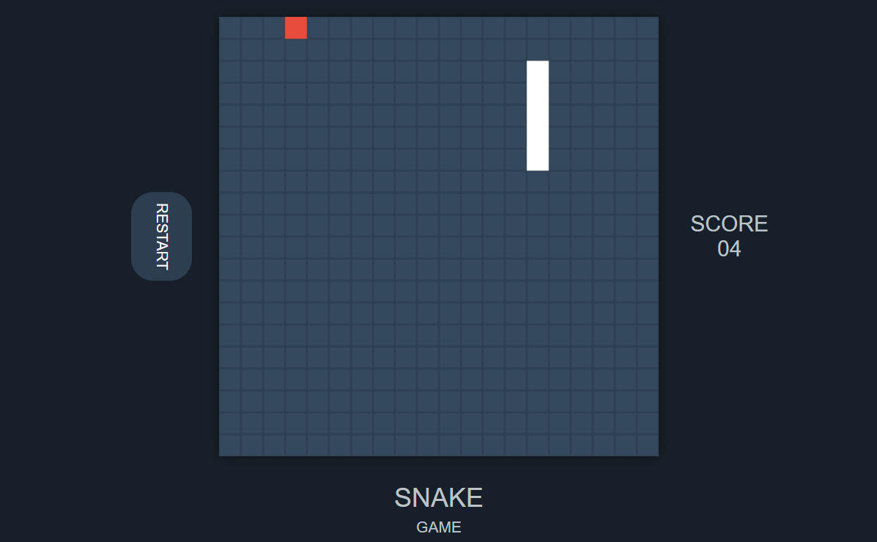
FINAL DESIGN
Portal to GAME
~A web GAME

Slide 13


Our Team : Team Dynamos
Vijay Kumar
Yashraj Shrivastava
SOT 128
SOT 134

Slide 14

Thank you for your time
Credit | Image: Unsplash

